Slide 1
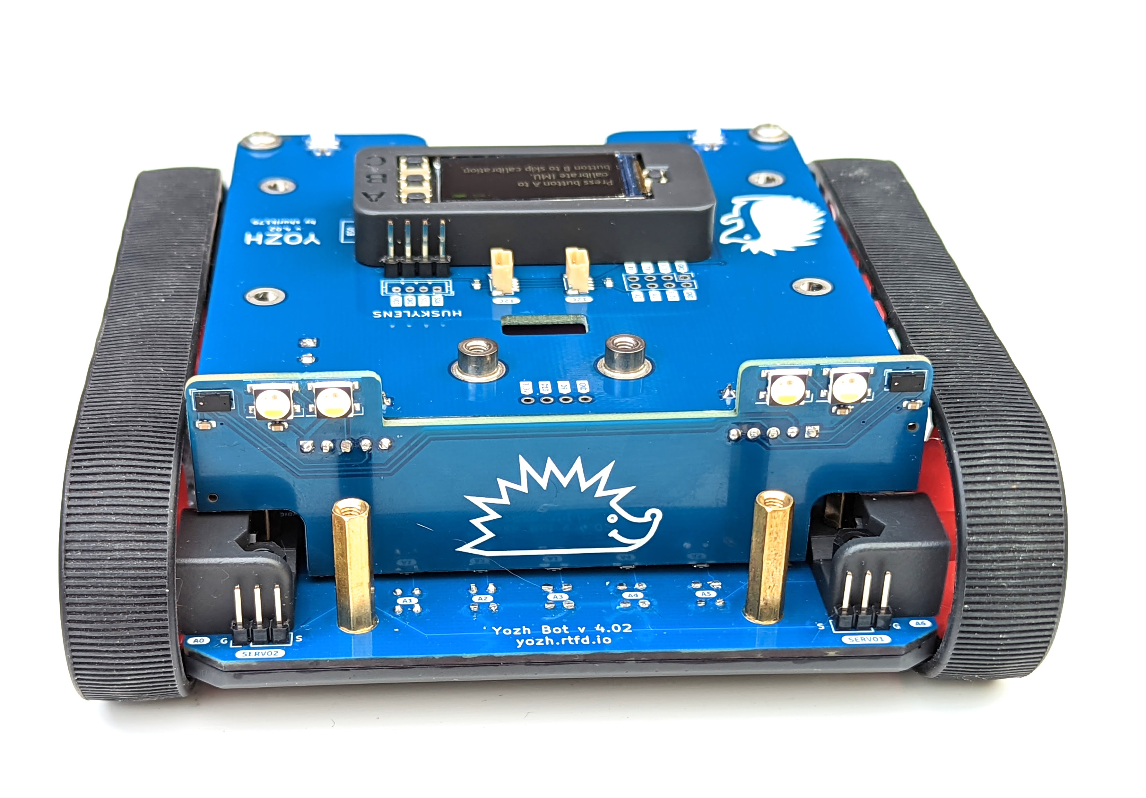
Distance
sensors
Reflectance array
Servo connectors

Slide 2
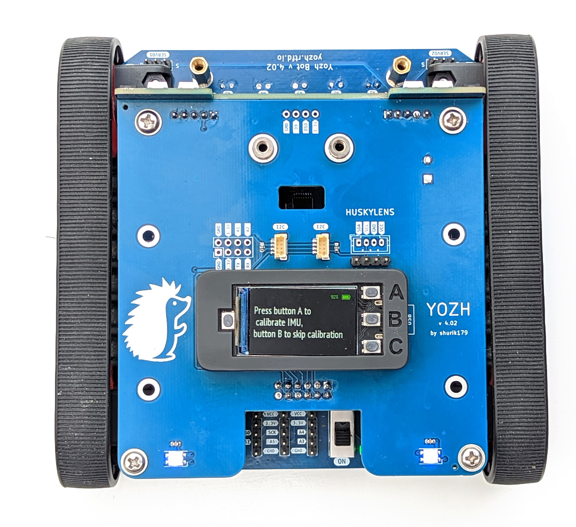
I2C connectors
Additional connectors
User buttons
Reset button
USB plug
NeoPixel LEDs

Slide 3
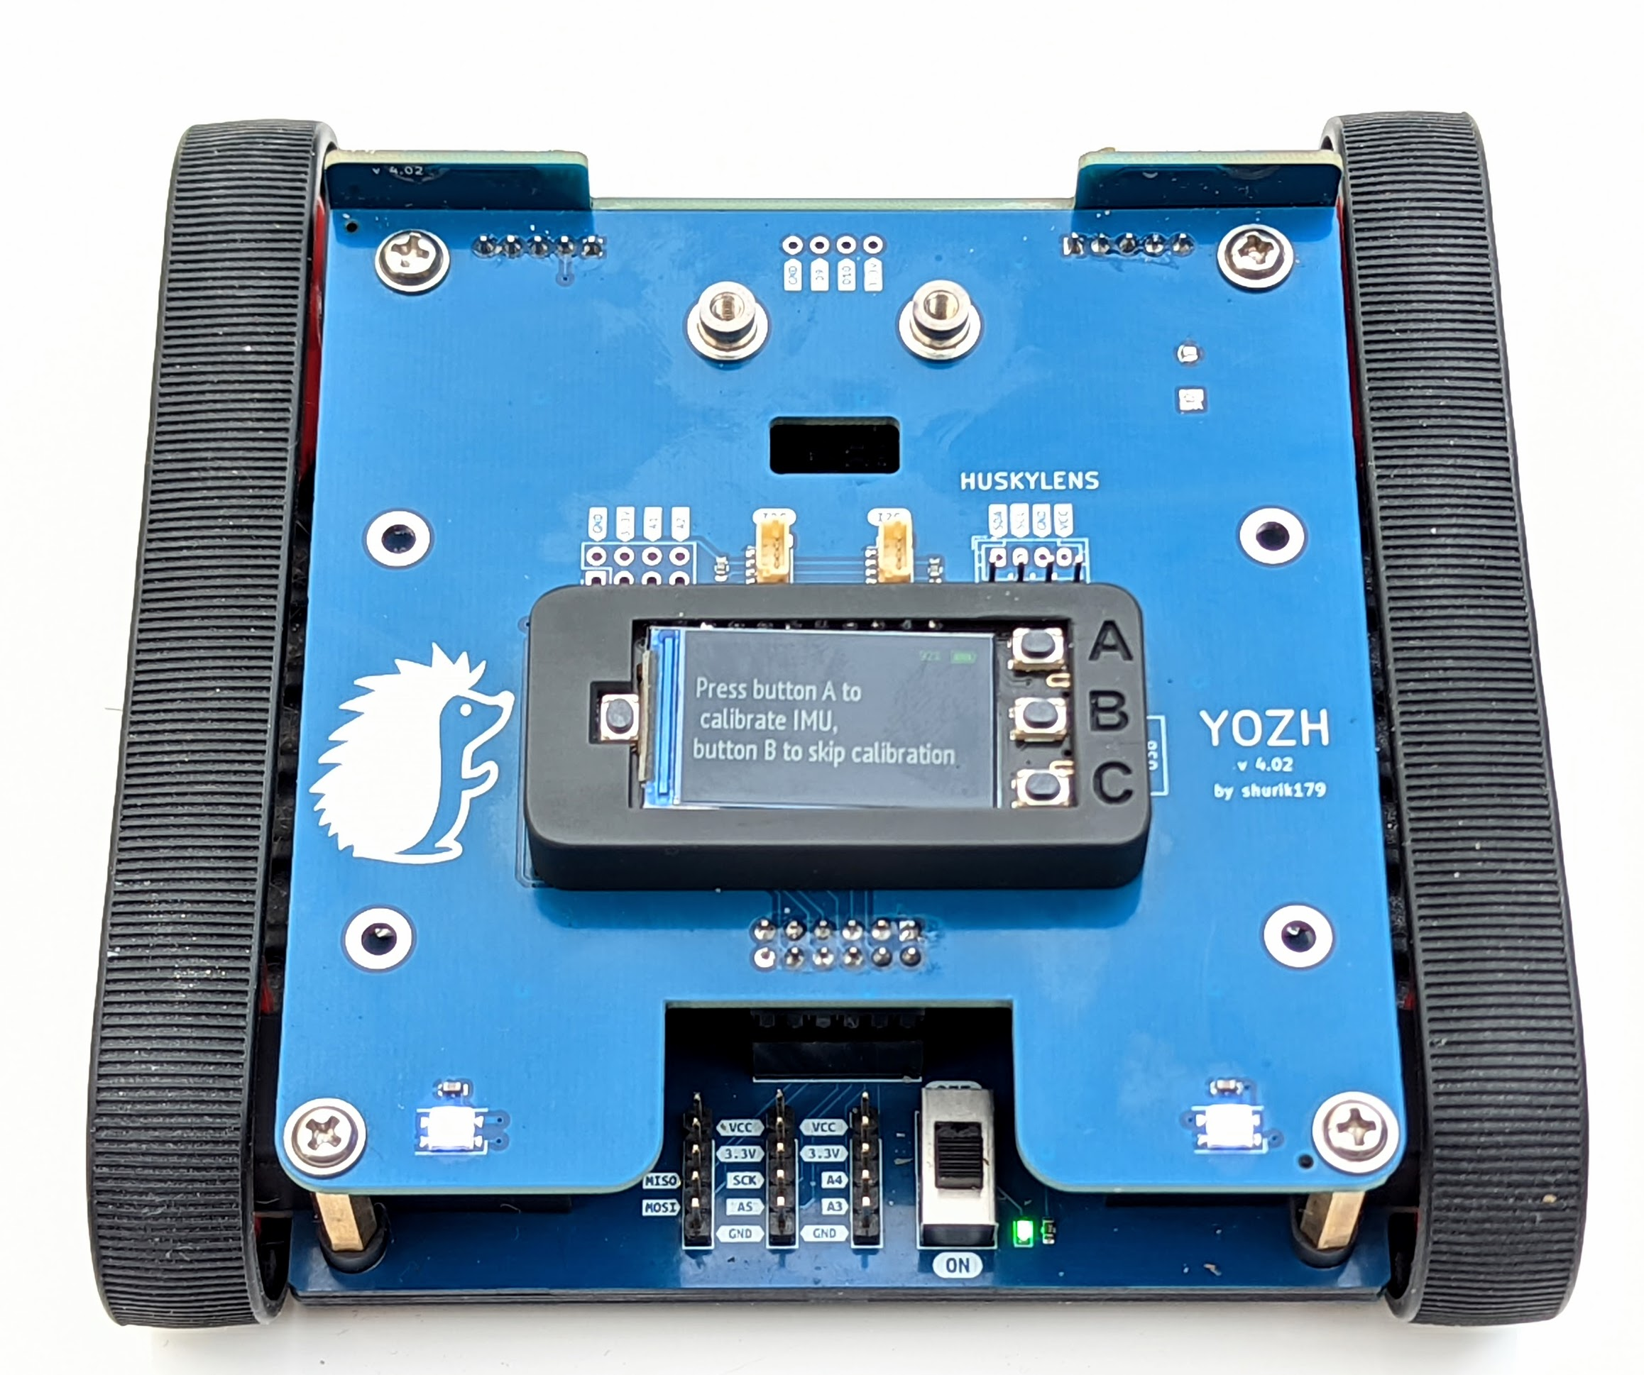
Additional connectors
Power switch
Power Indicator

Slide 4
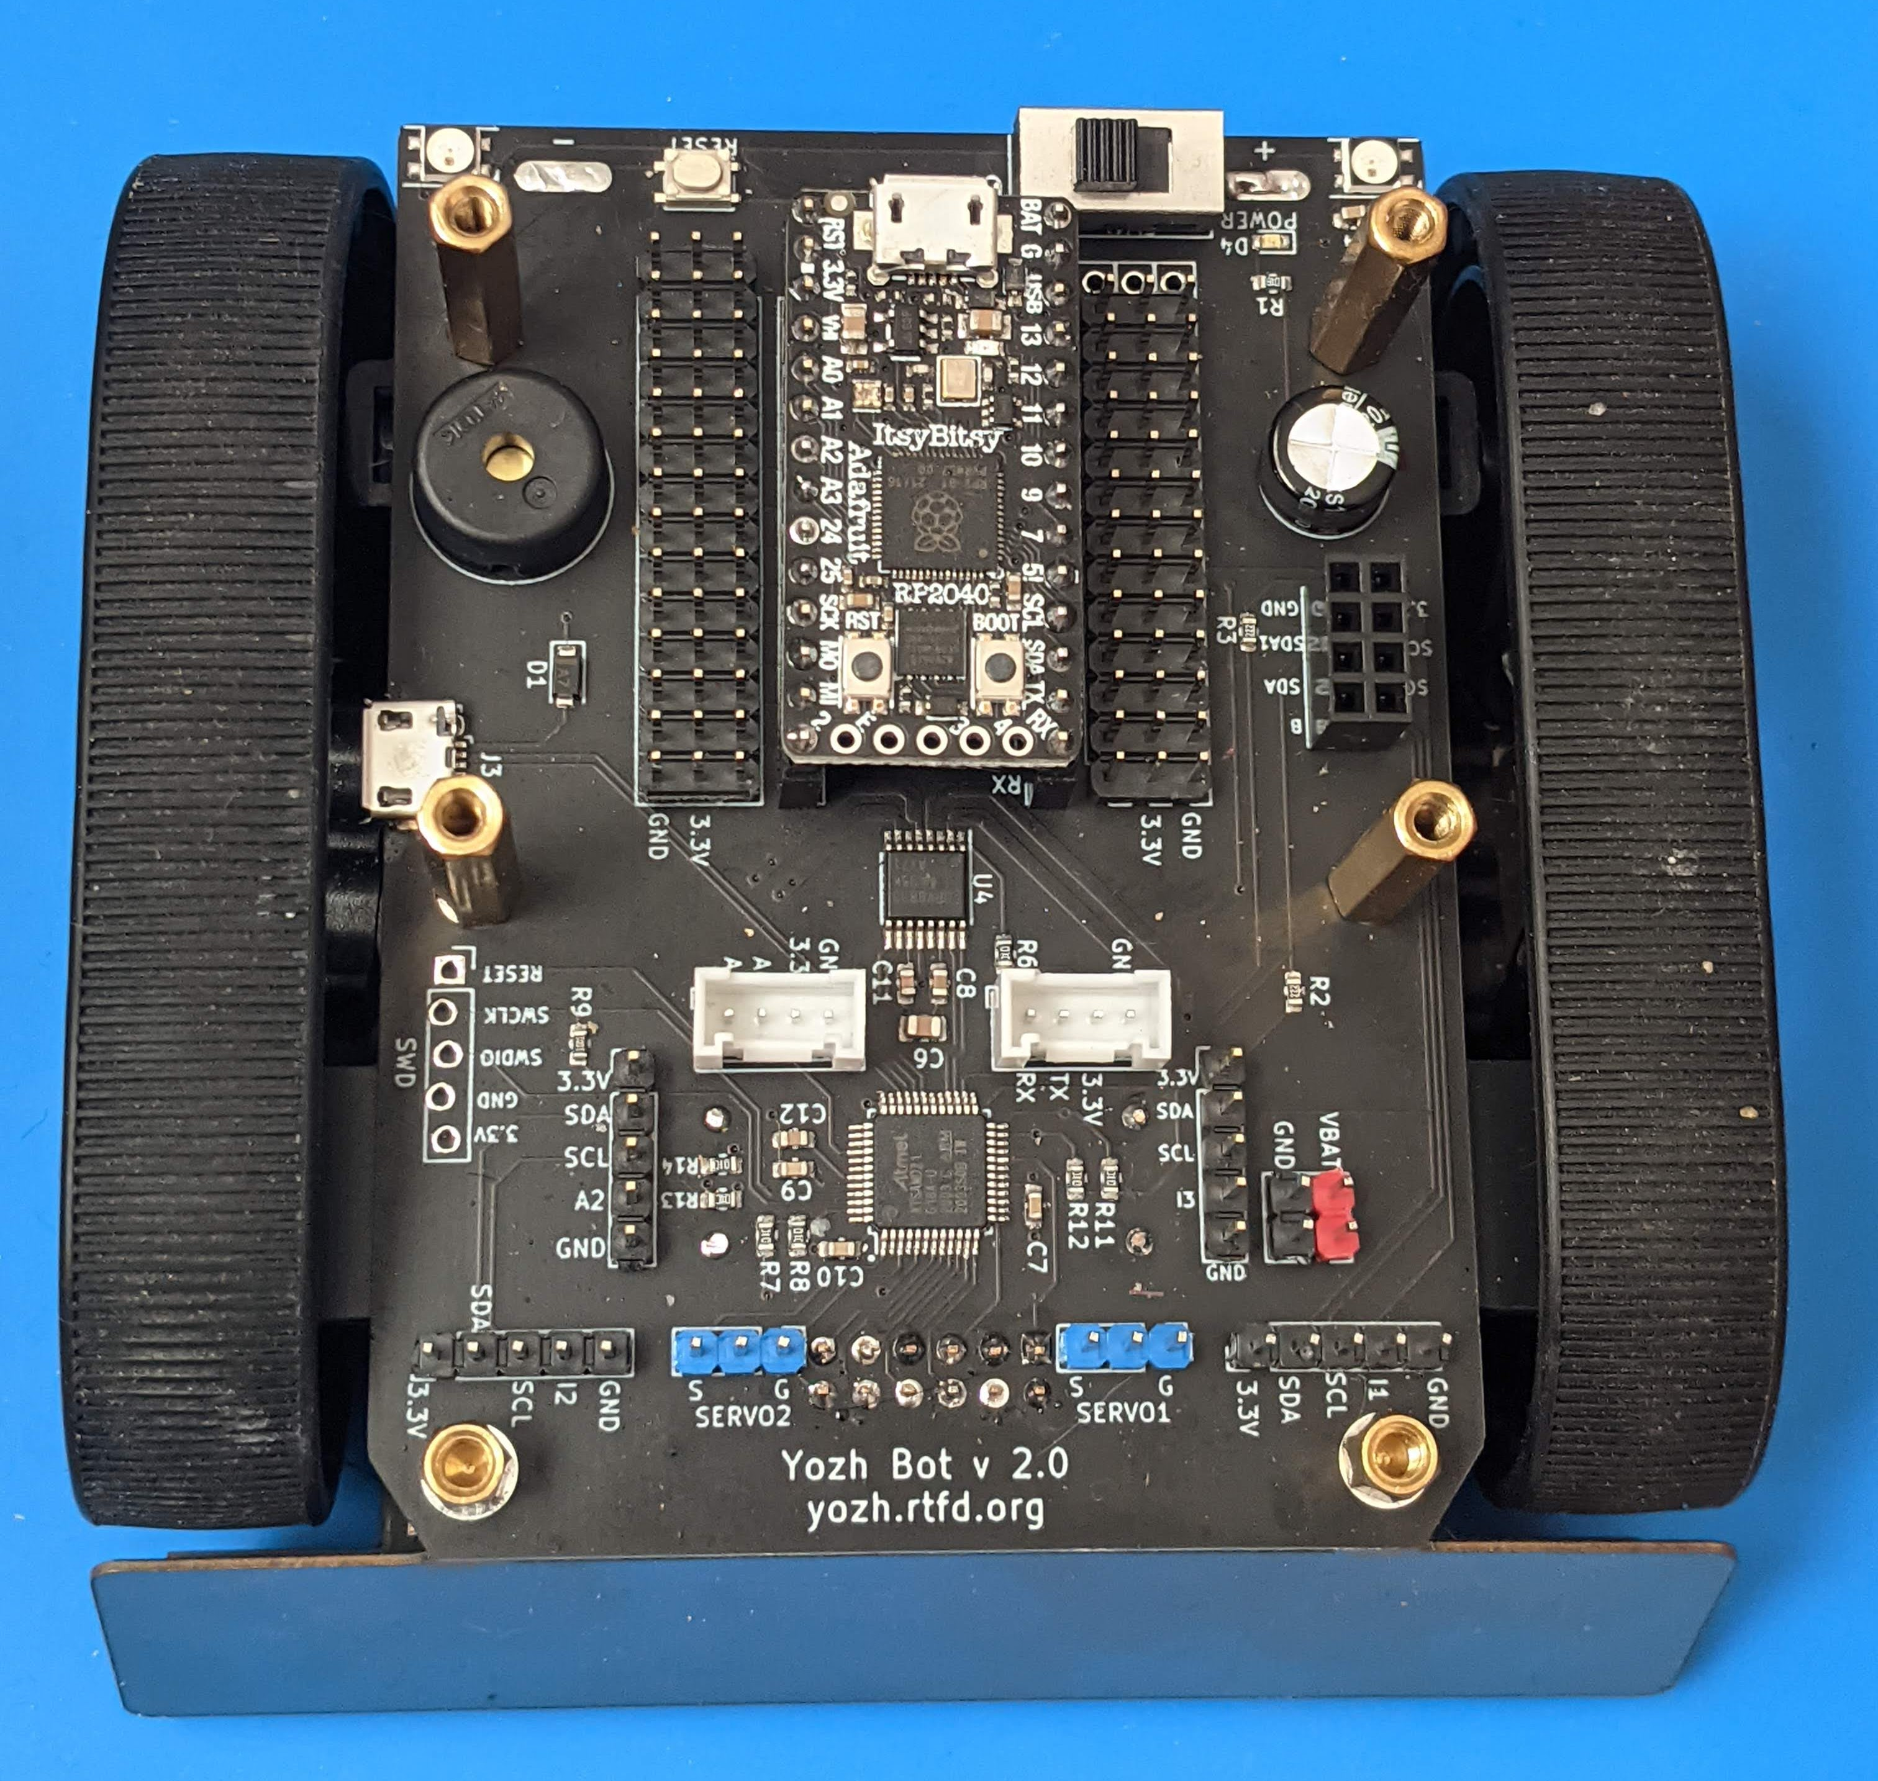
ItsyBitsy RP2040
BUZZER
SAMD21 USB
DRV8833 Motor driver
SAMD21 MCU

Slide 5
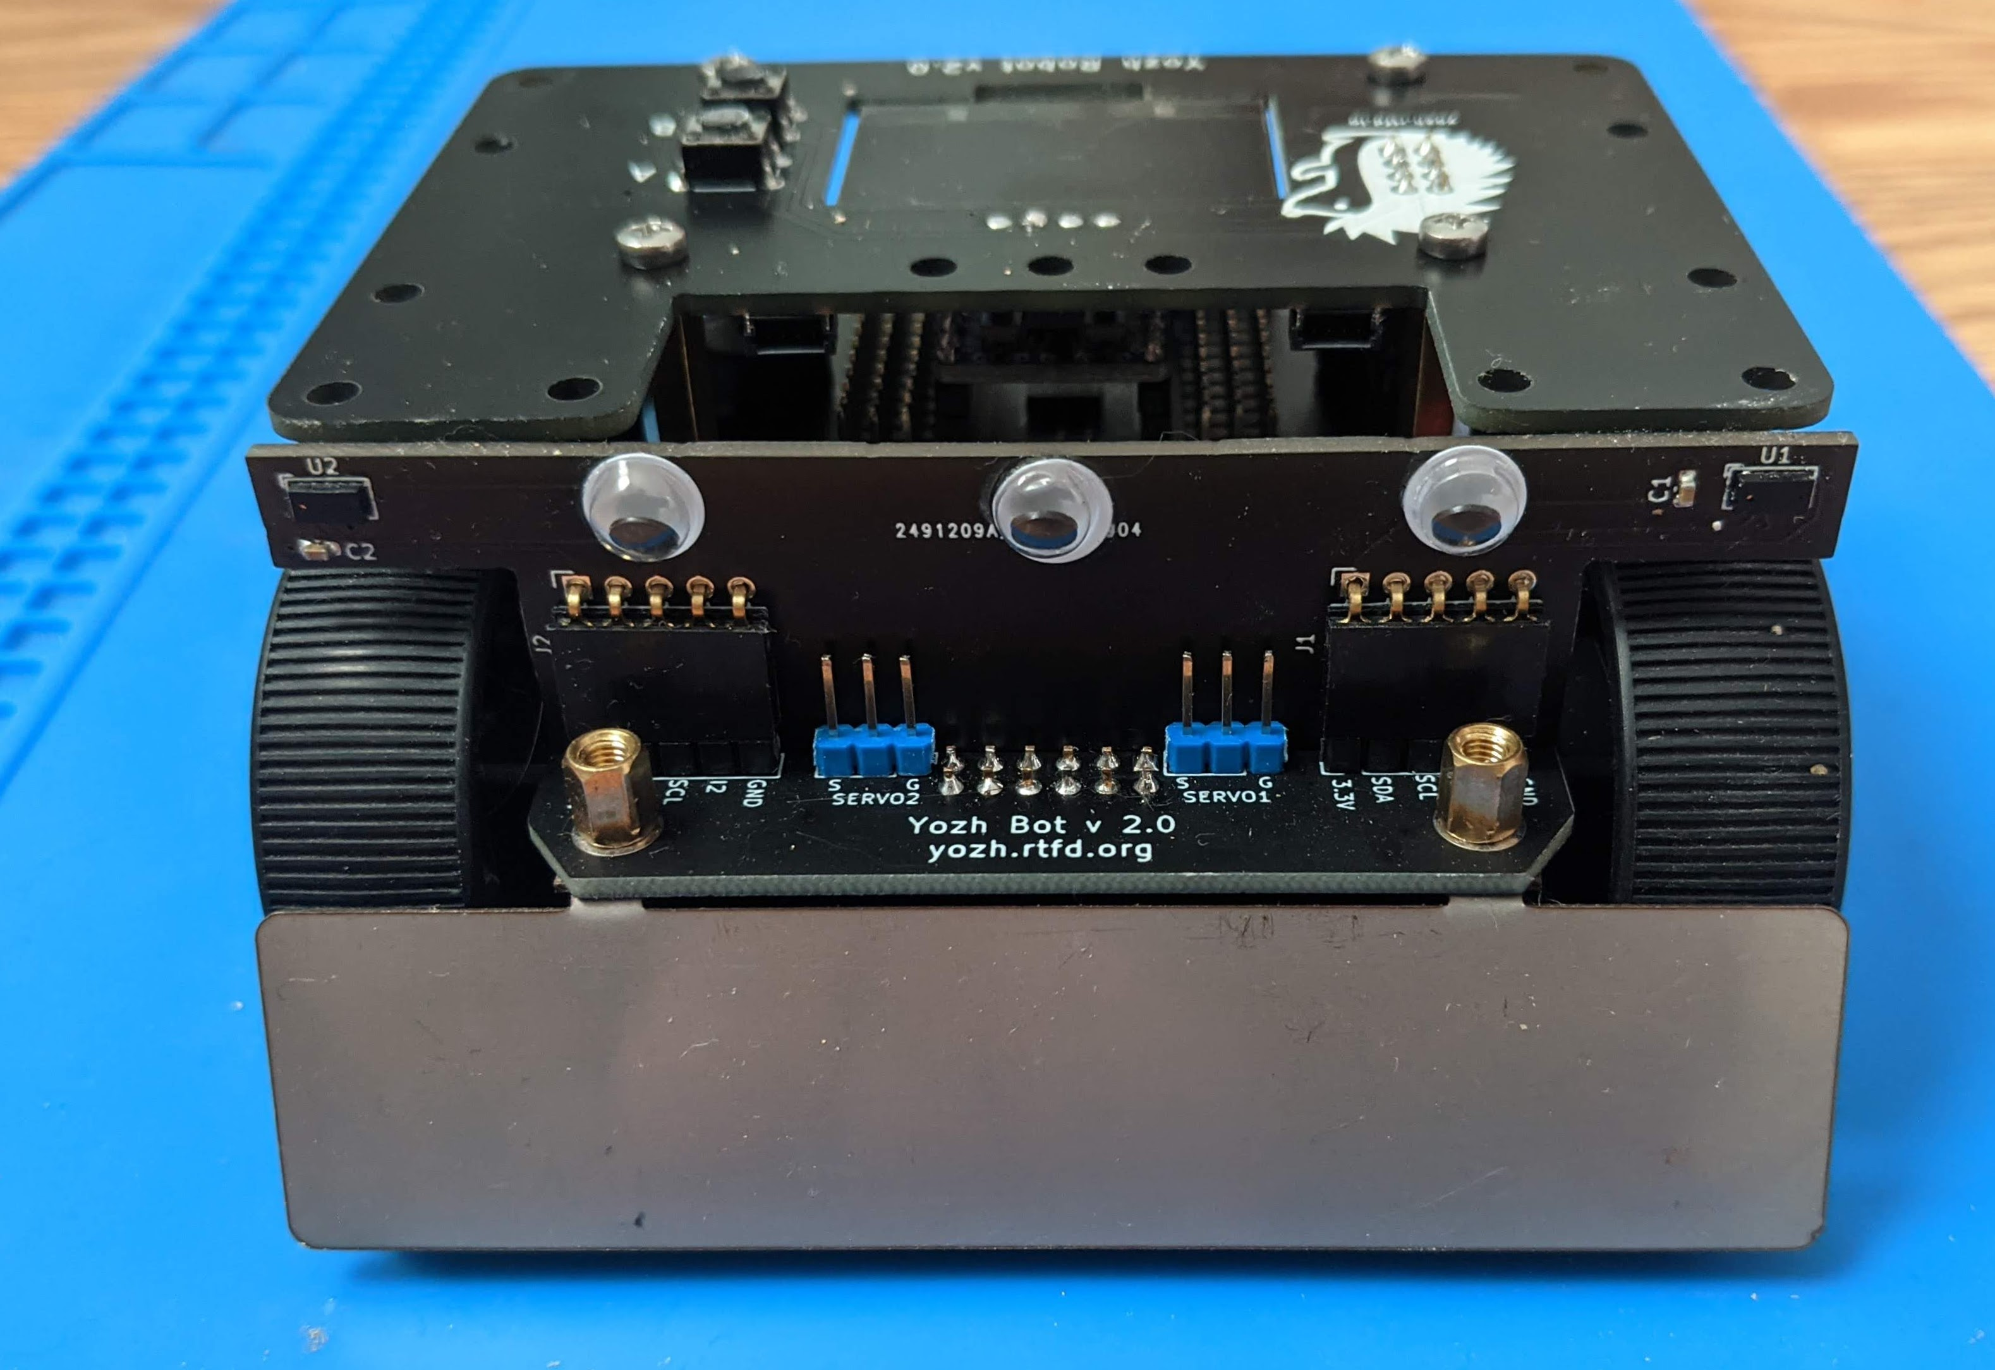
Distance sensors
Reflectance array (behind blade)
Blade

Slide 6
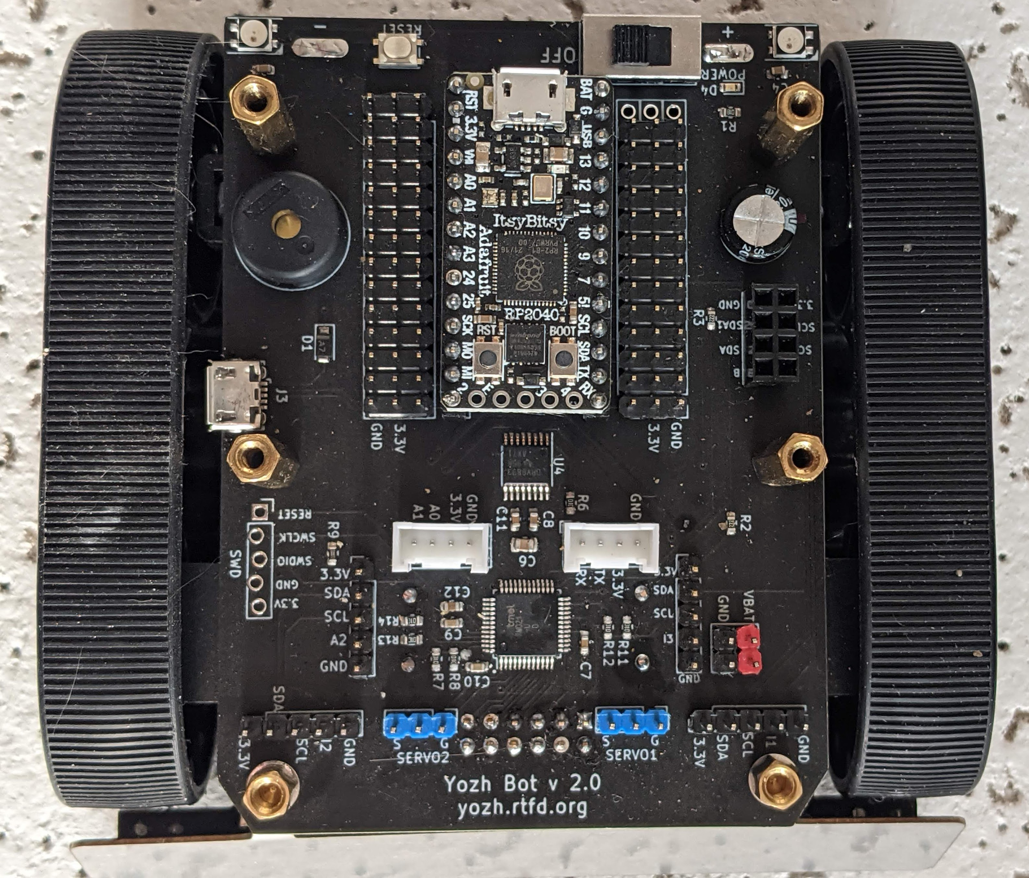
ItsyBitsy RP2040
BUZZER
SAMD21 USB (only for updating firmware)
DRV8833 Motor driver
SAMD21 MCU

